Slide 1
NSE
APIGEE MICROSERVICES

Slide 2
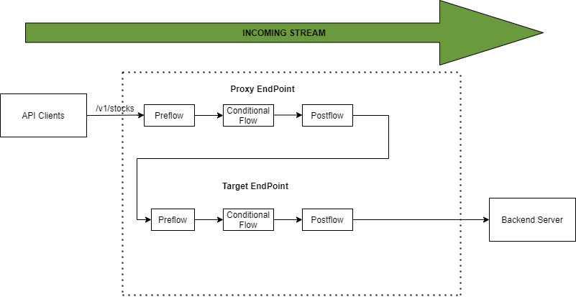
NSE APIGEE API Flow

Slide 3
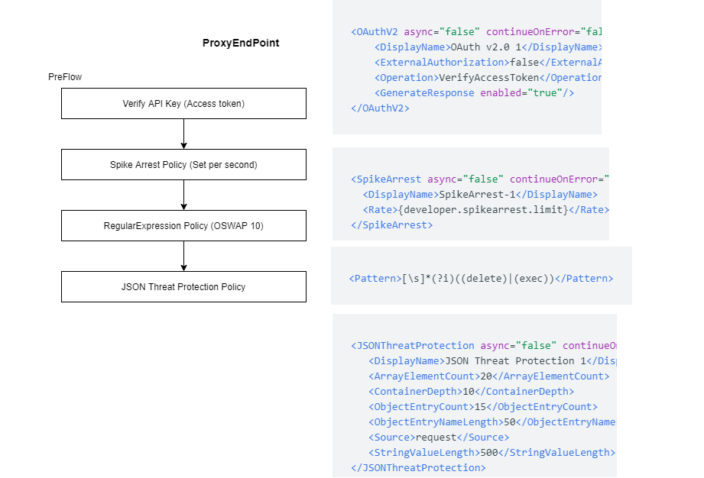
Proxy Endpoint Preflow

Slide 4
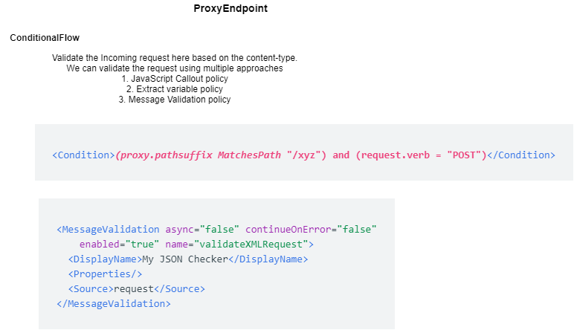
Proxy Endpoint Conditional Flow

Slide 5
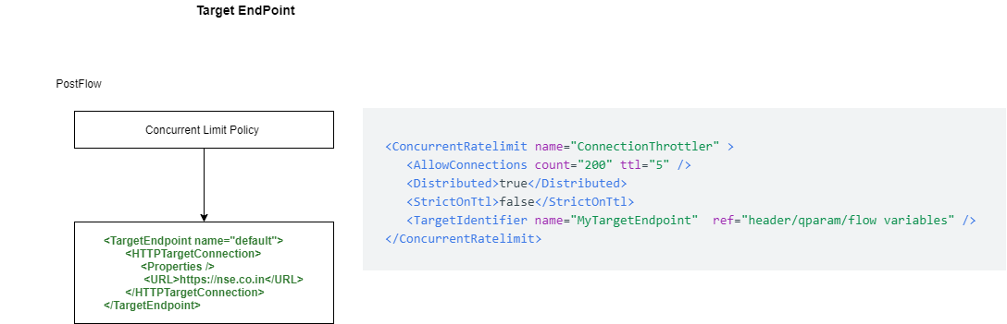
Target Endpoint

Slide 6
https://apigee.com/v1/xyz/{id}
GET
Target Endpoint: https://nse.com/v1/xyz/{id}
https://apigee.com/v1/xyz/{id}
Htpps://

